Slide 1
Smart Specialisation Strategy of Wallonia – State of play and outlook
18 May 2015, Brussels
Florence HENNART
Notes:
1

Slide 2
Smart Specialisation Strategy in Wallonia : a continuous process
2000-2010
Progressive development of the regional innovation Strategy
2012-2013
Peer review exercices : S3 Platform peer review and OECD Innovation policy peer review
2014-…
Evaluation of policies, Industrial value chains analysis
S3 synthesis document in annex of the ERDF OP (December 2014)
Translation into policy tools (New research and innovation Decree, Competitiveness Poles policy, Strucural funds,...)
Consolidation and deepening of the Smart Specialisation Strategy :
Marshall Plan 4.0 : adoption 21st may
Smart Specialisation Strategy for 2015-2019 to be adopted by the end of May : consolidation of a regional industrial innovation policy
Implementing of clustering policies (business clusters and Competitiveness Poles)
Marshall Plan and Marshall Plan 2.Green

Slide 3
The grounds of S3 in Wallonia
2001
2001 : launch of the business cluster policy, bottom-up
2006
2006-2009 : 1st Marshall Plan (1,6 billion €)
Launch of the Competitiveness Poles policy, 280 millions € (5 poles created). Mix of top-down and bottom-up approaches
2009
2015
2009-2014 : Marshall Plan 2.Green (2,75 billion €)
Pursuing and deepening the competitiveness Poles policy, 388 millions € – Creation of a 6th Pole (Green chemistry)
2015-2019 : Marshall Plan 4.0 (Human capital, Industrial and innovation policy, Attractiveness, Energy and circular economy, Digital economy)
⇨ Axis II: Deepening of S3 through Competitiveness Poles (316 millions €), new RDI Strategy, suppport to growth of enterprises
Pluriannual research strategy

Slide 4
The Competitiveness Poles at the core of our S3
Combination of top-down and bottom-up approaches
Collaborative approach : entreprises, universities, research centers, training centers
Cross-sectoral approach
Policy mix : support to R&D, innovation, investment, training, internationalisation (export and FDI)
Independant project selection process
+ Clusters : bottom-up SMEs networks

Slide 5
http://clusters.wallonie.be/ | Competitiveness Poles | Clusters
Industrial processes and new materials | MECATECH Mechanical engineering, materials and surfaces of the future, shaping of materials, additive manufacturing, microtechnology and mechatronics, intelligent maintenance and manufacturing | PLASTIWIN Plasturgy : polymers, engineering plastics, elastomers and rubbers, foamed products, composites, technical textiles
 | GREENWIN Green chemistry, environmental technologies, treatment and reuse of waste and effluents, waste water management, bio-sourced chemistry, management and storage of energy, sustainable building and renovation
 | LOGISTICS IN WALLONIA Transport, Logistics and Mobility: multimodality, sustainable logistics, supply chain security, internal logistics and management of industrial processes
 | SKYWIN Composites and metal materials, industrial processes, embedded systems, airport services, space applications and systems, modeling and simulations
Health and nutrition | BIOWIN Biomarkers, Diagnostics in vitro and in vivo, innovative tools and equipment, medication administration systems, innovative therapies (cell therapy, protontherapy), IT applied to human health, medical equipment, drug discovery, innovative processes and organizational innovations
 | WAGRALIM Health and nutritional quality of food, industrial efficiency, packaging and sustainable agro-food industry

Slide 6
http://clusters.wallonie.be/ | Pôles de Compétitivité | Clusters
Sustainable development - Sustainable building and energy | GREENWIN Green chemistry, environmental technologies, treatment and reuse of waste and effluents, waste water management, bio-sourced chemistry, management and storage of energy, sustainable building and renovation | TWEED Development of sustainable energy sectors: renewable energy sources, development of new processes and products for energy saving and energy efficiency
 |  | ECO-CONSTRUCTION Green building and green renovation
 |  | CAP 2020 Green building , low energy consumption building, energy-efficient building
Transport and mobility | LOGISTICS IN WALLONIA Transport, Logistics and Mobility: multimodality, sustainable logistics, supply chain security, internal logistics and management of industrial processes
 | SKYWIN Composites and metal materials, industrial processes, embedded systems, airport services, space applications and systems, modeling and simulations
Digital Technologies | Big Data innovation Platform | INFOPOLE CLUSTER TIC Smart mobility, e-health, green technologies, Internet of things, serious games, big data, open data, transmedia
 |  | TWIST 3D stereoscopic imaging, serious games, digital media, Internet and mobile content, scanning and digital archiving, motion recognition
 |  | PHOTONIQUE Laser and applications, measurement and control, vision and imaging optical components, photovoltaics, lighting technologies (LED)

Slide 7
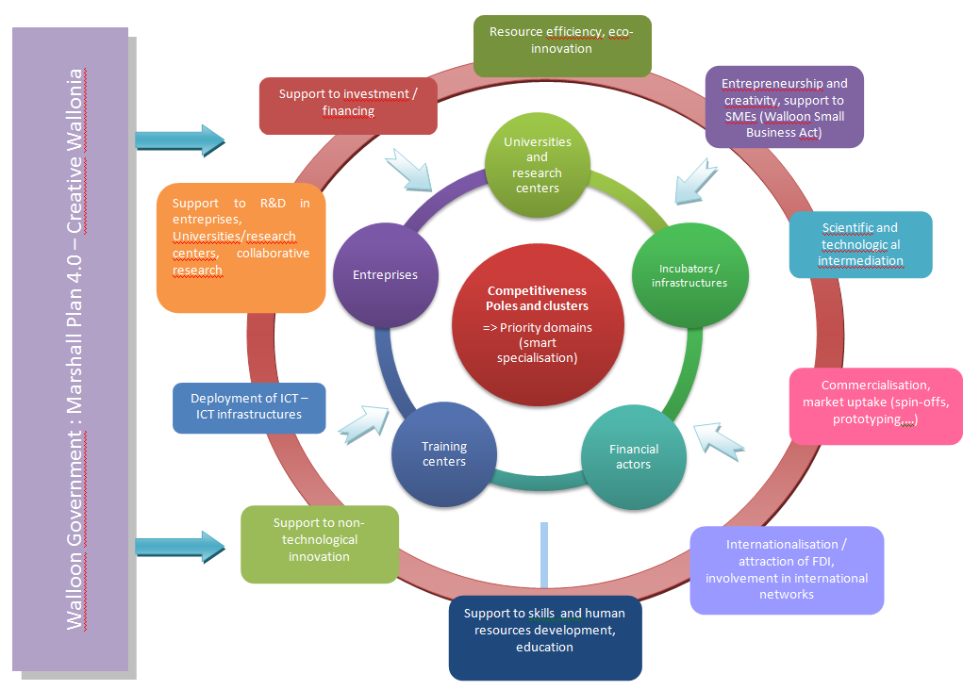
Building an efficient Policy Mix

Slide 8
Consolidation and deepening of our Strategy
Competitiveness Poles
Innovation, ICT, KET
Internation-alisation, Europe
Resource efficiency
Creative economy, high potential SMEs
New innovative value chains

Slide 9
Reverse Metallurgy : metal recycling from complex end-of-life products
41,5 Mio €
?
R&D projects
Innovation platform
Industrial prototypes and pilots / demonstration units
Training
Industrial investments, SMEs
Collaboration with Flanders: Leuven = co-location + IMEC, VITO, Ghent Univ., Umicore,…
Screening of H2020 calls

Slide 10
Additive Manufacturing
European Structural Funds
Support to the building regional potential : R&D, demonstrators, training,...
+ INTERREG ?
Collaboration with Flanders
Regional additive
manufacturing
Task Force :
Regional roadmap
Marshall Plan 4.0
Deployment within the regional ecosystem (SMEs)
Mapping and focusing on key strenghts and value chains, EU collaboration, network of demonstrators
INNOSUP 2015-1
Collaborative R&DI projects
ERA-NET
Juncker Plan, financial instruments

Slide 11
Conclusion
Competitiveness Poles Policy is a success in Wallonia, but remaining challenges
Smart specialisation as a (non-technocratic) continuous and open process
Strong potentialities in adopting a European perspective

Slide 12
Thanks for your attention !
http://economie.wallonie.be
http://clusters.wallonie.be
florence.hennart@spw.wallonie.be

